Slide 1
Murach’s Modern JavaScript
Chapter 11
More skills for working with arrays

Slide 2
Objectives
Applied
Inspect an array using the isArray(), find(), findIndex(), every(), and some() methods.
Sort an array by using the sort() method with a callback function.
Modify an array by using the forEach() method with a callback function.
Filter, map, and reduce the elements in an array.
Work with an array of arrays.
Knowledge
Describe how to destructure an array.
Distinguish between a shallow copy of an array and a deep copy.

Slide 3
A method of the Array object for checking an array
isArray(object)
An array that’s used by the following examples
const numbers = [1, 2, 3, 4, 5, 6, 7, 8, 9, 10];
Check that an object is an array
if (Array.isArray(numbers)) {
console.log("The numbers array has " +
numbers.length + " elements.");
}

Slide 4
Methods for inspecting an array
find(function)
findIndex(function)
every(function)
some(function)
Syntax of a callback function for these methods
function(current-element, [current-index], [array])

Slide 5
A named callback function that checks if a number is even
const isEvenNumber = elem => elem % 2 === 0;
Two ways to pass a callback function
Pass a named function
const val = numbers.find(isEvenNumber); // val is 2
Pass an anonymous function
const val = numbers.find(elem => elem % 2 === 0); // val is 2

Slide 6
Get the index for the first even number
const i = numbers.findIndex(elem => elem % 2 === 0);
// i is 1
Check if all or some of the elements are even numbers
const allEven = numbers.every(isEvenNumber); // false
const someEven = numbers.some(isEvenNumber); // true
Check if the array contains any repeating elements
const isRepeatNumber = (elem, i, arr) => elem === arr[i-1];
let hasRepeats = numbers.some(isRepeatNumber); // false
numbers.push(10);
hasRepeats = numbers.some(isRepeatNumber); // true

Slide 7
A method that sorts the elements of an array
sort()
sort(function)
The syntax of a callback function for this method
function(first-element-to-compare,
second-element-to-compare)
Possible return values for this callback function
Return value | Indicates
Less than zero | First value is less than second value.
Greater than zero | First value is greater than second value.
Zero | The values are equal.

Slide 8
A method of a string for comparing two strings
localeCompare(string)
Sort strings without a callback function (case-sensitive)
const names = ["Grace", "Ada", "bell", "Betsy"];
names.sort(); // ascending sequence
// names is ['Ada', 'Betsy', 'Grace', 'bell']
names.sort().reverse(); // descending sequence
// names is ['bell', 'Grace', 'Betsy', 'Ada']

Slide 9
Sort strings with a callback function (case-insensitive)
const names = ["Grace", "Ada", "bell", "Betsy"];
names.sort((a, b) =>
a.localeCompare(b)); // ascending sequence
// names is ['Ada', 'bell', 'Betsy', 'Grace']
names.sort((a, b) =>
b.localeCompare(a)); // descending sequence
// names is ['Grace', 'Betsy', 'bell', 'Ada']

Slide 10
Sort numbers
const nums = [7, 6, 25, 1, 3, 100];
nums.sort();
// unexpected – nums is [1, 100, 25, 3, 6, 7]
nums.sort((a, b) => a - b);
// ascending - nums is [1, 3, 6, 7, 25, 100]
nums.sort((a, b) => b - a);
// descending - nums is [100, 25, 7, 6, 3, 1]

Slide 11
Sort dates
const dates =
[new Date("7/4/2024"), new Date("1/1/2019")];
dates.sort((a, b) => a - b);
// ascending – dates is [1/1/2019, 7/4/2024]
names.sort((a, b) => b - a);
// descending – dates is [7/4/2024, 1/1/2019]

Slide 12
A method for working with each element in an array
forEach(function)
The syntax of a callback function for this method
function(current-element, [current-index], [array])

Slide 13
An array that’s used by the examples that follow
const numbers = [1, 2, 3, 4, 5, 6, 7, 8, 9, 10];
Two ways to loop through each element
With a for-of loop
let numberString = "";
for (let elem of numbers) {
numberString += "#" + elem + " ";
}
// numberString = "#1 #2 #3 #4 #5 #6 #7 #8 #9 #10 "
With the forEach() method
let numberString = "";
numbers.forEach(
elem => numberString += "#" + elem + " ");
// numberString = "#1 #2 #3 #4 #5 #6 #7 #8 #9 #10 "

Slide 14
Two ways to modify each element
With a for-in loop
for (let i in numbers) {
numbers[i] = numbers[i] * 2;
}
// numbers is [2, 4, 6, 8, 10, 12, 14, 16, 18, 20]
With the forEach() method
numbers.forEach((elem, i, arr) => arr[i] = elem * 2);
// numbers is [2, 4, 6, 8, 10, 12, 14, 16, 18, 20]

Slide 15
Methods that filter, map, and reduce array elements
filter(function)
map(function)
reduce(function, init)
The syntax of a callback function for the reduce() method
function(total, current-element, [current-index],
[array])

Slide 16
Create a new array with only even numbers
const evenNumbers =
numbers.filter(elem => elem % 2 === 0);
// evenNumbers is [2, 4, 6, 8, 10]
Create a new array with each element multiplied by 2
const doubled = numbers.map(elem => elem * 2);
// doubled is [2, 4, 6, 8, 10, 12, 14, 16, 18, 20]

Slide 17
Create a string that contains the element values
const str = numbers.reduce((total, elem) =>
total + "#" + elem + " ", "");
// str is "#1 #2 #3 #4 #5 #6 #7 #8 #9 #10 "
Sum the element values
const sum = numbers.reduce((total, elem) =>
total + elem, 0);
// sum is 55

Slide 18
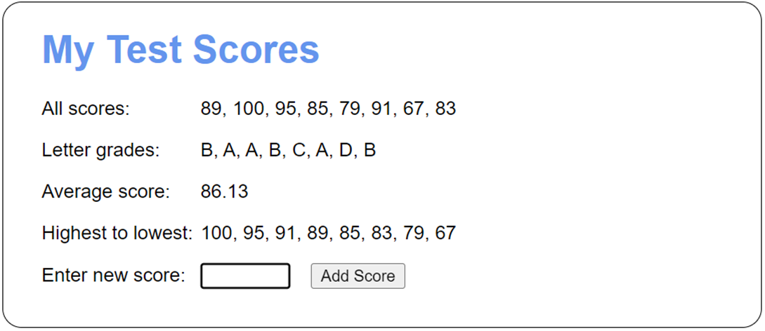
The Test Scores app

Slide 19
The HTML for the <body> element of the Test Scores app (part 1)
<body>
<h1>My Test Scores</h1>
<div>
<label>All scores:</label>
<label id="all"></label>
</div>
<div>
<label>Letter grades:</label>
<label id="grades"></label>
</div>
<div>
<label>Average score:</label>
<label id="avg"></label>
</div>
<div>
<label>Highest to lowest:</label>
<label id="sort"></label>
</div>

Slide 20
The HTML for the <body> element of the Test Scores app (part 2)
<div>
<label for="score">Enter new score:</label>
<input type="text" id="score">
<button id="add_score">Add Score</button>
<span></span>
</div>
<script src="test_scores.js"></script>
</body>

Slide 21
The JavaScript for the Test Scores app (part 1)
const getElement = selector =>
document.querySelector(selector);
document.addEventListener("DOMContentLoaded", () => {
const scores = [];
getElement("#add_score").addEventListener(
"click", () => {
// clear any previous error message
getElement("#add_score").nextElementSibling
.textContent = "";
// get score entered by user and validate
const score =
parseFloat(getElement("#score").value);
if (isNaN(score) || score < 0 || score > 100) {
getElement("#add_score").nextElementSibling
.textContent =
"Score must be from 0 to 100.";
}

Slide 22
The JavaScript for the Test Scores app (part 2)
else { // score is valid
// add score to scores array
scores.push(score);
// display all scores
getElement("#all").textContent =
scores.join(", ");
// display letter grades for scores
const grades = scores.map(elem => {
if (elem >= 90) return "A";
else if (elem >= 80) return "B";
else if (elem >= 70) return "C";
else if (elem >= 60) return "D";
else return "F";
});

Slide 23
The JavaScript for the Test Scores app (part 3)
getElement("#grades").textContent =
grades.join(", ");
// calculate and display average score
const sum = scores.reduce((total, elem) =>
total + elem, 0);
const avg = sum/scores.length;
getElement("#avg").textContent =
avg.toFixed(2);
// display the scores sorted in descending
// order
const sortedScores = scores.slice(); // copy
sortedScores.sort((a, b) => b - a);
getElement("#sort").textContent =
sortedScores.join(", ");
}

Slide 24
The JavaScript for the Test Scores app (part 4)
// get text box ready for next entry
getElement("#score").value = "";
getElement("#score").focus();
});
// set focus on initial load
getElement("#score").focus();
});

Slide 25
The syntax to destructure an array
const|let [identifier-1, identifier-2, ...] = arrayName;
Two arrays that are used by the following examples
const totals = [141.95, 76, 312.80, 9.99];
const fullName = ["Grace", "M", "Hopper"];
Assign the first three elements in an array
const [total1, total2, total3] = totals;
// total1 is 141.95, total2 is 76, total3 is 312.80
Skip an array element
const [firstName, , lastName] = fullName;
// firstName is "Grace", lastName is "Hopper"

Slide 26
Use a default value
const [first, middle, last, suffix = "none"] = fullName;
// first is "Grace", middle is "M", last is "Hopper",
// suffix is "none"
Use the rest operator to assign some elements to a new array
const[total1, total2, ...remainingTotals] = totals;
// total1 is 141.95, total2 is 76,
// remainingTotals is [312.80, 9.99]
Destructure a string
const [first, second, third] = "USA";
// first is "U", second is "S", third is "A"

Slide 27
Create an array of arrays
// create an empty students array
const students = [];
// add two arrays of scores to the students array
// directly
students[0] = [80, 82, 90, 87, 85];
students[1] = [79, 80, 74];
// add two more arrays to the students array with the
// push() method
students.push([93, 95, 89, 100]);
students.push([60, 72, 65, 71]);
// refer to elements in the nested arrays
console.log(students[0][1]); // displays 82
console.log(students[2][3]); // displays 100
// refer to an element in the outer array
console.log(students[1]); // displays [79, 80, 74]

Slide 28
Create an array of arrays with mixed data types
const invoice = [];
const lineItem1 = ["Duct Tape", 5.99, 2];
const lineItem2 = ["12-Inch Zip Ties", 3.99, 5];
invoice.push(lineItem1);
invoice.push(lineItem2);
// refer to elements in the nested arrays
console.log(invoice[0][0]); // displays "Duct Tape"
console.log(invoice[1][1]); // displays 3.99

Slide 29
Loop through an array of arrays
let str = "";
for (let i in students) { // outer loop
const scores = students[i];
const id = Number(i) + 1;
str += "Student " + id + ": ";
for (let score of scores) { // nested loop
str += score + "|";
}
str += "\n";
}
console.log(str);
The string that’s displayed in the console
Student 1: 80|82|90|87|85|
Student 2: 79|80|74|
Student 3: 93|95|89|100|
Student 4: 60|72|65|71|

Slide 30
Loop through another array of arrays
let str = "NAME|PRICE|QTY|TOTAL\n";
for (let lineItem of invoice) { // outer loop
for (let column of lineItem) { // nested loop
str += column + "|";
}
const total = lineItem[1] * lineItem[2];
str += total.toFixed(2) + "\n";
}
console.log(str);
The string that’s displayed in the console
NAME|PRICE|QTY|TOTAL
Duct Tape|5.99|2|11.98
12-Inch Zip Ties|3.99|5|19.95

Slide 31
Sort an array of arrays
// sort by the first score in ascending order
students.sort((a, b) => a[0] - b[0]);
// sort by the average score in descending order
students.sort((a, b) =>
(b.reduce((total, elem) =>
total + elem, 0) / b.length) -
(a.reduce((total, elem) =>
total + elem, 0) / a.length));

Slide 32
Sort another array of arrays
// sort by name in ascending sequence
invoice.sort((a, b) => a[0].localeCompare(b[0]));
// sort by price in ascending sequence
invoice.sort((a, b) => a[1] - b[1]);
// sort by total in ascending sequence
invoice.sort((a, b) => (a[1] * a[2]) - (b[1] * b[2]));

Slide 33
A method that flattens an array
flat(depth)
Flatten a two-dimensional array
const array2D = [[1, 2, 3], [4, 5, 6], [7, 8, 9]];
const array1D = array2D.flat();
// array1D is [1, 2, 3, 4, 5, 6, 7, 8, 9]
Flatten a three-dimensional array
const array3D = [["Math", [85, 70]],
["English", [92, 96]]]
const array2D = array3D.flat();
// array2D is ["Math", [85, 70], "English", [92, 96]]
const array1D = array3D.flat(2);
// array1D is ["Math", 85, 70, "English", 92, 96]

Slide 34
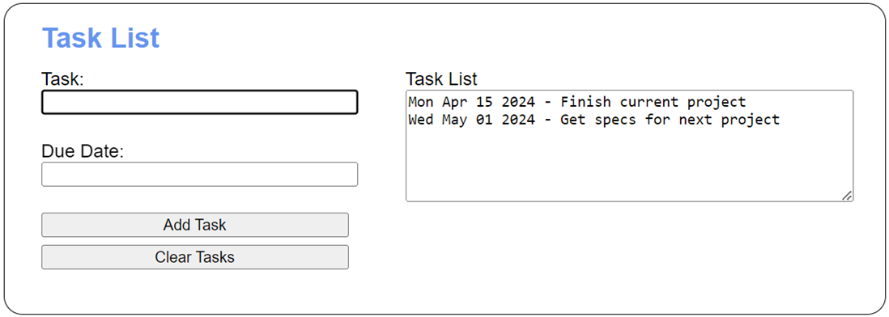
The Task List app

Slide 35
The <body> element of the Task List app (part 1)
<body>
<h1>Task List</h1>
<div id="tasks">
<label for="task_list">Task List</label><br>
<textarea id="task_list" rows="6" cols="50">
</textarea>
</div>
<div>
<label for="task">Task:</label><br>
<input type="text" name="task" id="task">
</div>
<div>
<label for="due_date">Due Date:</label><br>
<input type="text" name="due_date" id="due_date">
</div>

Slide 36
The <body> element of the Task List app (part 2)
<div>
<input type="button" id="add_task"
value="Add Task"><br>
<input type="button" id="clear_tasks"
value="Clear Tasks">
</div>
<p id="message"></p>
<script src="task_list.js"></script>
</body>

Slide 37
The JavaScript for the Task List app (part 1)
const getElement = selector => document.querySelector(selector);
const getDisplayString = tasks => {
if (tasks.length === 0) {
return "";
} else {
// convert stored date string to Date object
tasks = tasks.map(task => [task[0], new Date(task[1])]);
// sort by date (second element)
tasks.sort((task1, task2) => task1[1] - task2[1]);
// return display string – concat date and event
return tasks.reduce((str, task) =>
str += task[1].toDateString() + " - " +
task[0] + "\n", "");
}
};

Slide 38
The JavaScript for the Task List app (part 2)
document.addEventListener("DOMContentLoaded", () => {
const taskString = localStorage.tasks ?? null;
const tasks = JSON.parse(taskString) ?? [];
getElement("#add_task").addEventListener("click", () => {
// clear previous message
getElement("#message").textContent = "";
const task = getElement("#task").value;
const dateString = getElement("#due_date").value;
const dueDate = new Date(dateString);
if (task && dateString && dueDate.toString() !==
"Invalid Date") {
tasks.push([task, dueDate]);
localStorage.tasks = JSON.stringify(tasks);
getElement("#task").value = "";
getElement("#due_date").value = "";
getElement("#task_list").value =
getDisplayString(tasks);
getElement("#task").focus();

Slide 39
The JavaScript for the Task List app (part 3)
} else {
getElement("#message").textContent =
"Please enter a task and valid due date.";
getElement("#task").select();
}
});
getElement("#clear_tasks").addEventListener("click", () => {
tasks.length = 0;
localStorage.removeItem("tasks");
getElement("#task_list").value = "";
getElement("#task").focus();
});
getElement("#task_list").value = getDisplayString(tasks);
getElement("#task").focus();
});

Slide 40
Code that fails to copy an array
const names = ["Grace", "Charles", "Ada"];
const names2 = names; // This doesn’t copy the array!
names2[1] = "Brendan";
// names and names2 are ["Grace", "Brendan", "Ada"]

Slide 41
Two ways to make a shallow copy of an array
Call the slice() method of the array.
Use an array literal with a spread operator and the array.
Code that copies an array
const names = ["Grace", "Charles", "Ada"];
const namesCopy1 = names.slice();
const namesCopy2 = [...names];
// namesCopy1 and namesCopy2 are
// ["Grace", "Charles", "Ada"]

Slide 42
Code that attempts to call an array method from a NodeList object
const items = document.querySelectorAll("li");
const text = items.reduce((tot, el) =>
tot + el.textContent + " ", "");
// TypeError – items is a NodeList object, reduce()
// not available

Slide 43
A method of the Array object for copying an array
from(array)
Get an Array object from a NodeList object
// copy items NodeList as an Array
const itemsArr = Array.from(items);
const text = itemsArr.reduce((tot, el) =>
tot + el.textContent + " ", "");
// works – itemsArr is an Array object,
// reduce() is available
Get an Array object from a NodeList object in one statement
const items =
Array.from(document.querySelectorAll("li"));

Slide 44
A two-dimensional array that’s used in the following examples
const numbers = [1, [2, 3, 4], 5, 6];
What happens when you make a shallow copy
const shallowCopy = [...numbers];
// change a top-level value in the copy –
// only copy changes
shallowCopy[0] = 10;
console.log(shallowCopy[0]); // displays 10
console.log(numbers[0]); // displays 1
// change a nested value in the copy –
// copy and original change
shallowCopy[1][0] = 20;
console.log(shallowCopy[1][0]); // displays 20
console.log(numbers[1][0]); // displays 20

Slide 45
How to make a deep copy
const deepCopy = JSON.parse(JSON.stringify(numbers));
// change a nested value in the copy – only copy changes
deepCopy[1][0] = 20;
console.log(deepCopy[1][0]); // displays 20
console.log(numbers[1][0]); // displays 2

